Slide 2
M.S Counseling Program
Advisory Board
June 3, 2025

Slide 3
Agenda
Welcome
Dean’s Update
VP Gillece Welcome
Chair's Update
Program Director Update
Field Placement Updates
NCE and Program Evaluation Results
Action Plan and Discussion

Slide 4
Welcome & Introductions
Share first/last name, current employer/title & Hood affiliation

Slide 5
Dean’s Update
Strategic Plan – Year 3
Enrollment
Retention

Slide 6
Welcome from VP Gillece

Slide 7
Chair's Update
Faculty and staff updates
HRSA grants and NCTC
Programmatic/Curricular updates
Notes:
Megan

Slide 8
Faculty changes
Dr. Megan Shaine now Psychology and Counseling department chair
Dr. Erik Messinger now Counseling M.S program director
Dr. Shannon Shoemaker served as School Counseling placement coordinator this year
Successful search that hired Dr. Nouf Bazaz to start in August 2025 as School Counseling Program Director
Notes:
Megan

Slide 9
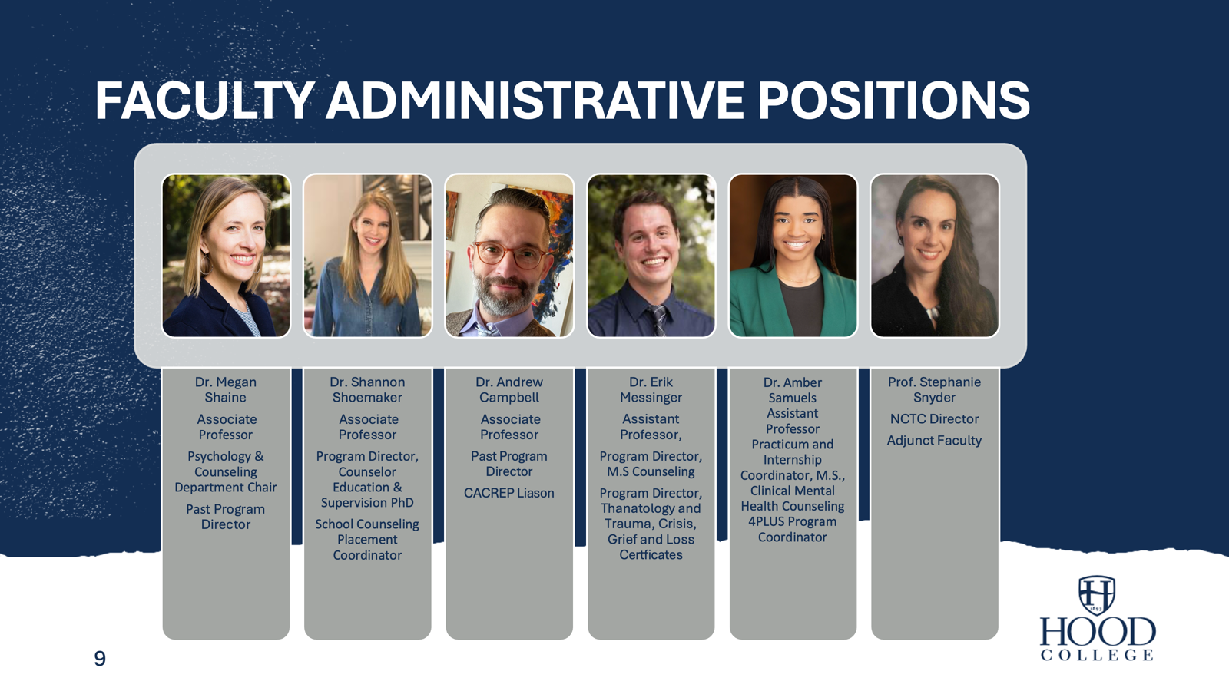
Faculty Administrative Positions
Dr. Megan Shaine
Associate Professor
Psychology & Counseling Department Chair
Past Program Director
Dr. Shannon Shoemaker
Associate Professor
Program Director, Counselor Education & Supervision PhD
School Counseling Placement Coordinator
Dr. Andrew Campbell
Associate Professor
Past Program Director
CACREP Liason
Dr. Erik Messinger
Assistant Professor,
Program Director, M.S Counseling
Program Director, Thanatology and Trauma, Crisis, Grief and Loss Certficates
Prof. Stephanie Snyder
NCTC Director
Adjunct Faculty
Dr. Amber Samuels Assistant Professor Practicum and Internship Coordinator, M.S., Clinical Mental Health Counseling 4PLUS Program Coordinator
Notes:
Megan

Slide 10
Curricular updates
Success of certificate programs
Growing 4-Plus PSY/COUN program
Addition of popular 1-credit electives
  Art Therapy for Trauma Counseling
  Nature-Informed Counseling
Practicum and internship sections limited to 8 students
  Three practicum sections for Summer 2025
Notes:
Megan

Slide 11
grants
HRSA Scholarships for Disadvantaged Students closing out June 30, 2025
HRSA Behavioral Health Workforce Education and Training (BHWET)
  Applied for a continuation of Strength in Training Equity (SITE) program for 2025-29
    Waiting to hear back
    Provides $10,000 stipends to internship students and funding for one-credit electives, trainings, and staffing for NCTC
Notes:
Megan

Slide 12
Director’s Update
Admissions and enrollment
Employment updates
Practicum and Internship
NCE
Notes:
Erik

Slide 13
Recruitment Update
Recruitment remains steady
Large interest in admissions cafes
Regular meetings with PD for all tracks
Working to strengthen school counseling recruitment
Notes:
Erik

Slide 14
Enrollment Update
Spring 2025: 49 applications
  18 enrolled
Fall 2025: 64 applications
  18 to start this fall
Intentionally taking smaller classes moving forward to keep 12:1 required accreditation ration
Notes:
Erik

Slide 15
Program graduates
32 counseling graduates from September 2024 to June 2025
  Highest number yet!
  6 School Counseling
  26 Clinical Mental Health Counseling
Notes:
Erik

Slide 16
2024-2025 Alumni Employment
CMHC
Outdoor Therapeutics
Advanced Behavioral Health
Washington Psychological Wellness
Peak Therapy
The Orenda Center
School
Montgomery County Public Schools
Washington County Public Schools
Laurel Hall School
Bullis School
Notes:
Erik

Slide 17
Practicum & internship updates: Cmhc
Currently 38 students in the field; 24 in Practicum and 14 in Internship I
Approximately 16 students slated to
start practicum in Spring '26
Added 14 new sites; 5 additional are pending final approval
  Group private practices, community mental health settings, virtual intensive outpatient
Notes:
Amber

Slide 18
NEWLY ADDED SITES FOR CMHC (Maryland)
Frederick, MD (N=6) | Other Maryland Locations (N=5)
Aion Trauma Center | Breakthrough Therapeutic Concepts (Severna Park)
Clearview Communities | Guiding Therapy (Annapolis)
Wells House | Life Renewal Services (Westminster)
LifeChange Therapy Now | Vertex Counseling and Wellness (Germantown)
Phoenix Recovery Academy | Goody Counseling (Lutherville)
Mind Body Wellness
Notes:
Amber

Slide 19
NEWLY ADDED SITES FOR CMHC (cont'd)
Virginia, MD (N=2) | Virtual Intensive Outpatient (N=1)
Comprehensive Counseling Services (Winchester) | Charlie Health
Connections4Life (Leesburg)
Notes:
Amber

Slide 20
Practicum & internship updates: School Counseling
Updates
  Moved to Fall and Spring starts only with no summer option due to limited opportunities for placement
  New SC Practicum & Internship Manual Developed
  New protocols and procedures developed
Placements
  Spring 2025: 7 in practicum, 6 in Internship II
  Fall 2025 (expected): 3 in practicum, 7 in Internship I
Notes:
Shannon

Slide 21
Neighborhood Counseling training center
January – May: supported 21 Site Fellows and Practicum Volunteers at NCTC
Summer 2025: 9 Site Fellows, 2 International Students, and 8 Practicum students
732 Individual sessions provided January 2025 – May 8th, 2025
187 hours of direct supervision provided by Director Stephanie Snyder from January 2025 to May 2025.
Top presenting concerns:
  Generalized Anxiety Disorder
  Major Depressive Disorder
  Adjustment Disorder
  Unspecified Problem Related to Psychosocial Circumstances
Notes:
Steph

Slide 22
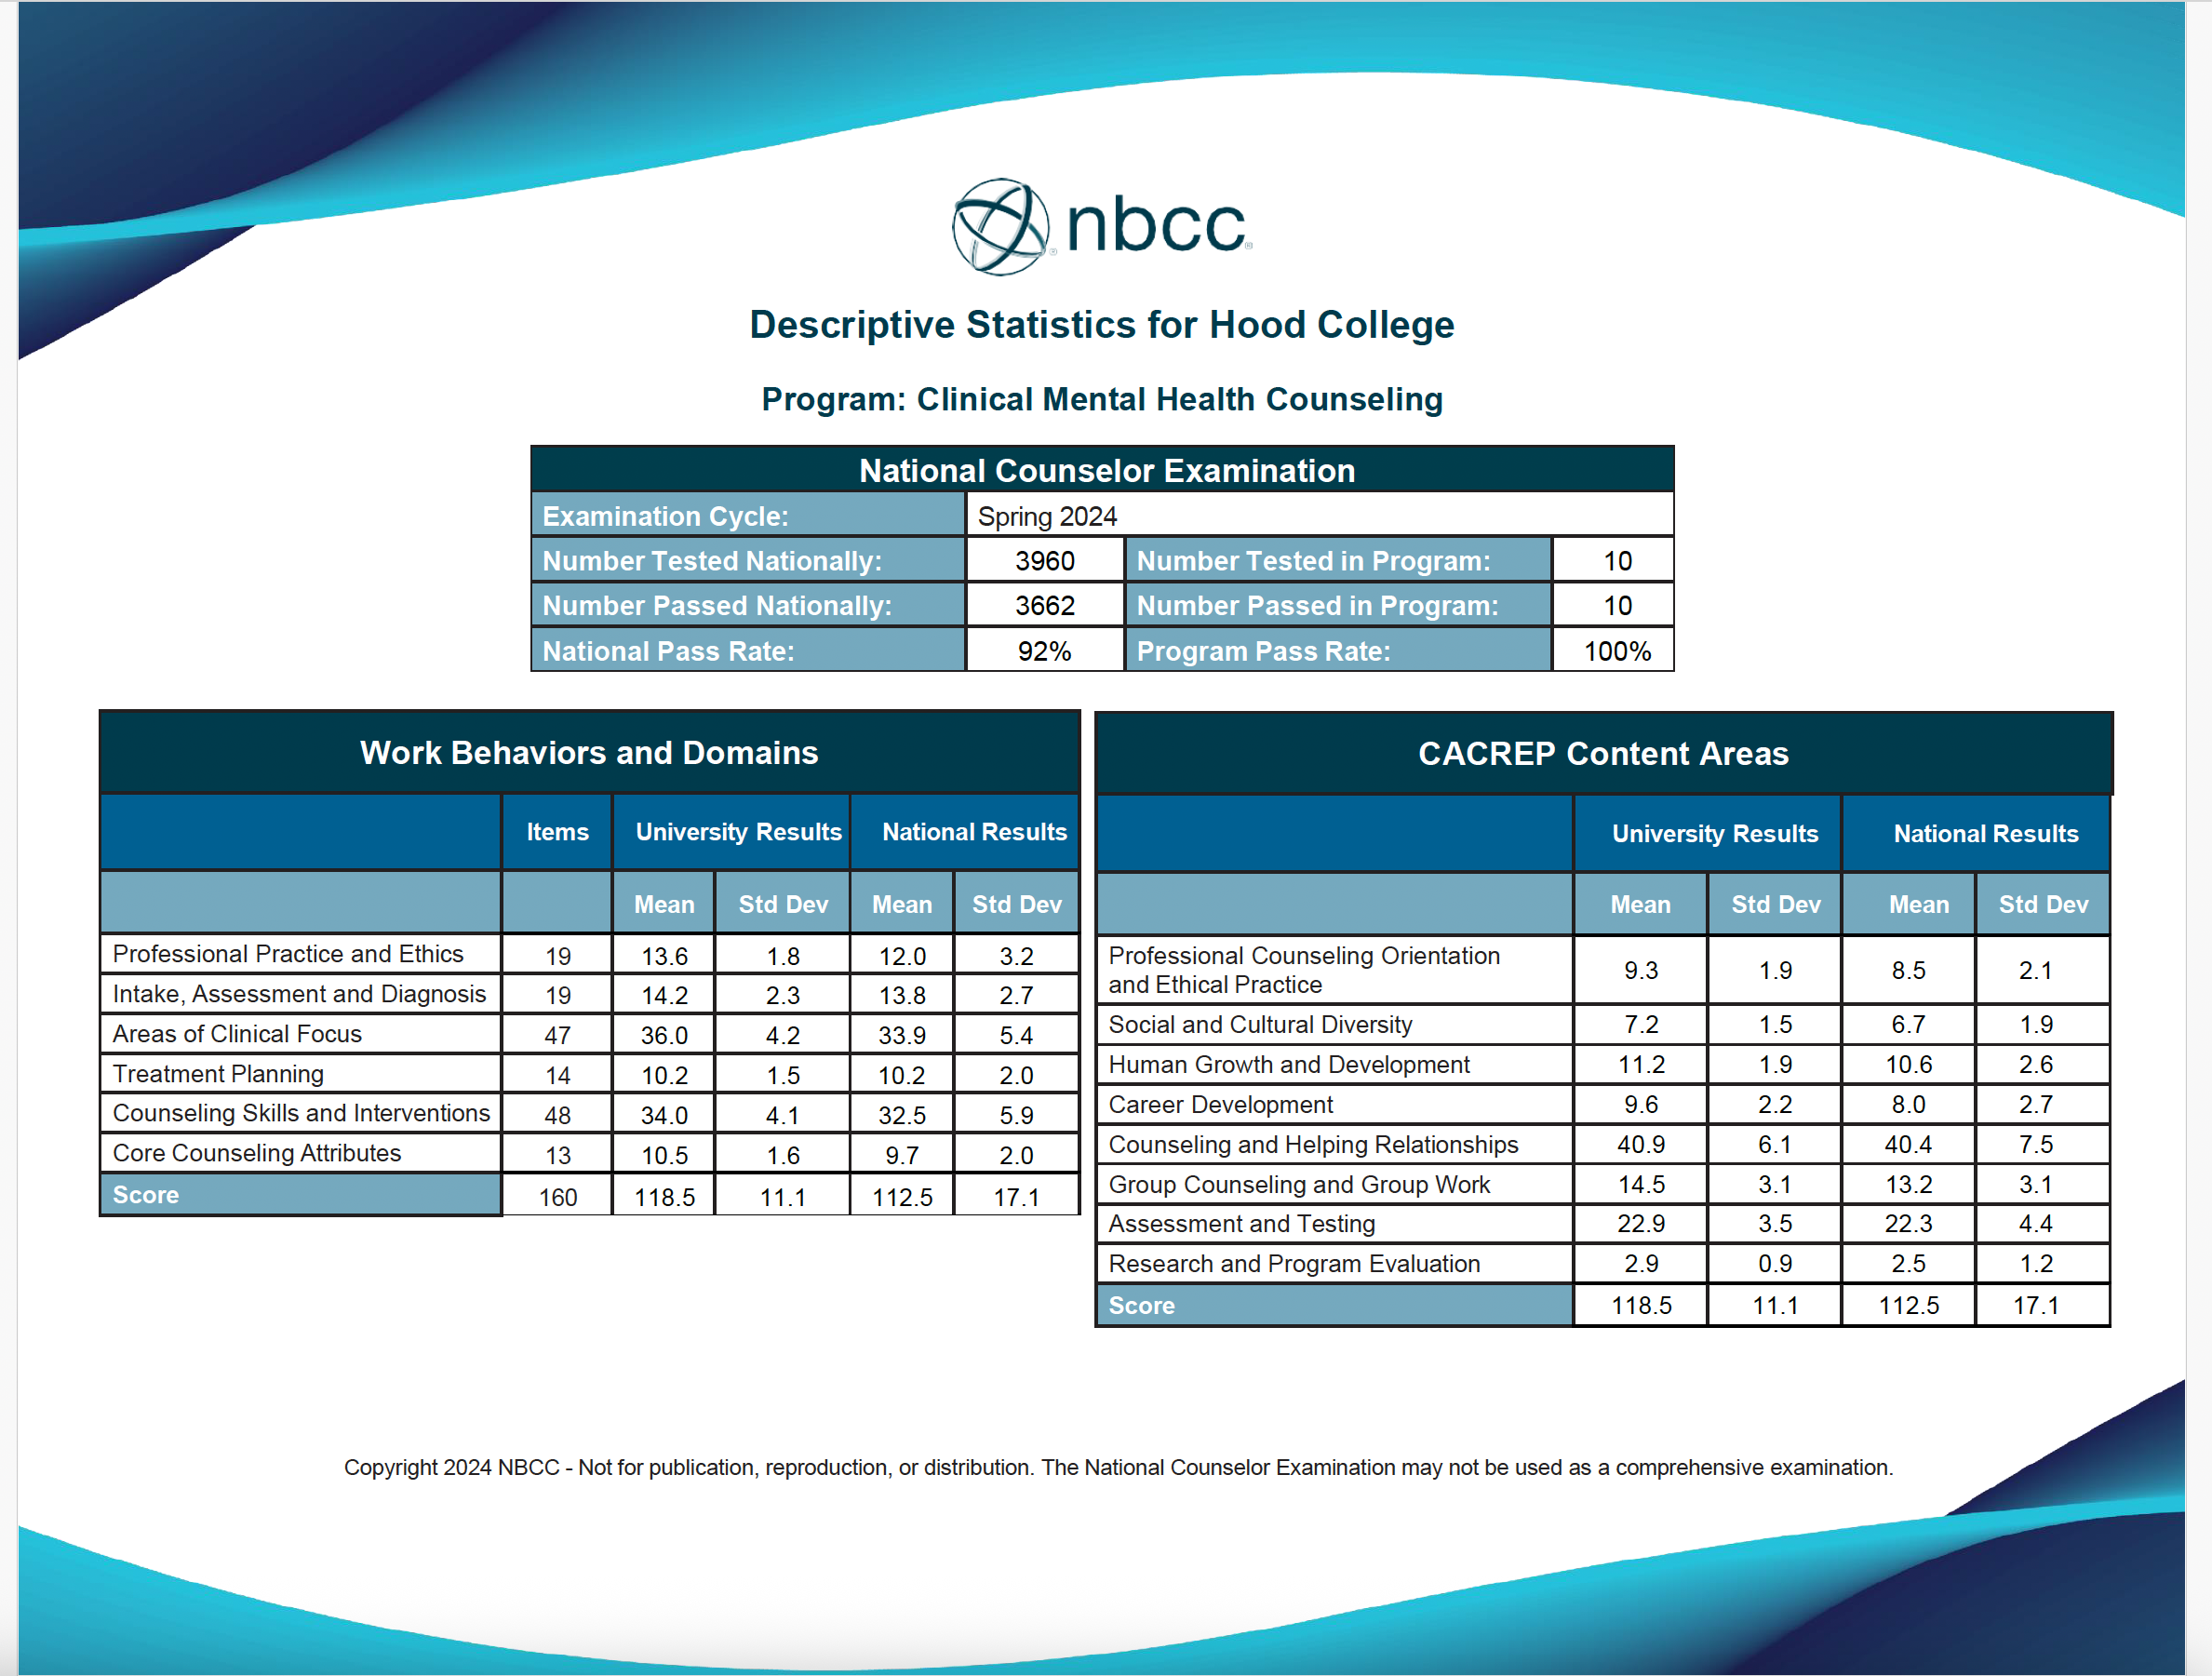
NCE results
Sti
Notes:
Steph?

Slide 23
Program Evaluation
KPI | 2020-2021 | 2021-2022 | 2022-2023 | 2023-2024 | 2024-2025
Overall Mean | 3.51 (88%) | 3.58 (89%) | 3.57 (89%) | 3.66 (89%) | 3.73 (91%)
1 – Roles & Responsibilities | 3.77 | 3.83 | 3.80 | 3.72 | 3.83
2 – Ethics | 3.89 | 3.61 | 3.80 | 3.77 | 3.93
3 – Multicultural Counseling | 3.49 | 3.37 | 3.48 | 3.7 | 3.7
4 – Human Development | 3.52 | 3.39 | 3.43 | 3.61 | 3.8
5 – Career Counseling | 3.43 | 3.71 | 3.67 | 3.89 | 3.88
6 – Theories | 3.42 | 3.42 | 3.40 | 3.64 | 3.66
7 – Interviewing Techniques | 3.48 | 3.59 | 3.49 | 3.7 | 3.65
8 – Group Counseling | 3.51 | 3.62 | 3.80 | 3.68 | 3.77
9 – Assessment | 3.51 | 3.53 | 3.58 | 3.57 | 3.79

Slide 24
Program Evaluation
KPI | 2020-2021 | 2021-2022 | 2022-2023 | 2023-2024 | 2024-2025
10 – Risk, Trauma, & Abuse | 3.15 | 3.43 | 3.27 | 3.55 | 3.83
11 – Research & Evaluation | 3.69 | 3.50 | 3.64 | 3.66 | 3.6
12 – Acad. Ach., Coll./Car. Read. | - | 3.71 | 3.17 | 3.69 | 3.71
13 – School Collab. & Consult. | 3.55 | 3.68 | 3.85 | 3.72 | 3.57
14 – School Prog. Dev. & Eval. | 3.24 | 3.46 | 3.72 | 3.37 | 3.42
15 – School Mental Health | 3.33 | 3.43 | 3.34 | 3.58 | 3.18
16 – Diagnosis and Tx. Plan. | 3.55 | 3.46 | 3.56 | 3.41 | 3.57
17 – Clinical Contexts & Doc. | 3.75 | 3.89 | 4.00 | 3.66 | 3.79
18 – Substance Use | 3.32 | 3.75 | 3.93 | 3.96 | 3.89

Slide 25
Program Evaluation
Consistency in overall mean (3.72 from 3.66 in 2024)
Improvements (>.15) in KPIs associated with ethics/professionalism, human development, assessment, risk, and diagnosis
No substantive declines (>.15) in performance on any core KPIs
Difference in overall performance by specialty (3.79 for CMHC, 3.59 for school)
  CMHC with higher mean scores for 17 of 18 KPIs

Slide 26
Program Assessment - Demographics
Race/Ethnicity
Gender
No overall difference by race/ethnicity
Improvements for students of color on ethics, assessment, diagnosis, clinical roles
Improvements for white students on diagnosis
No overall difference between performance by gender
  Men perform better regarding school programming, groups
Improvement by men on cross-cultural counseling, groups
*Transgender and non-binary students not included due to low number

Slide 27

Program Assessment - Clinical
Progress & Successes
Substantive improvements related to ethics/professionalism, human development, assessment and risk
Good performance on all KPIs (>3.5)
  Exemplary performance (>3.75) on 11 of 14 clinically relevant KPIs
Congrats to us!

Slide 28
Program Assessment - School
Progress & Successes
Declines & Areas of Work
Good performance on 10 of 15 school-related KPIs
Improvements in performance related to professional identity, ethics, and risk assessment
  Surprising successes in clinical areas, including diagnosis
Declines in career and theory
Poor performance (<3.5) on groups, theory, school-based collaboration, program development, and school mental health (3.06)

Slide 29
Assessment Considerations
Continued discrepancies in performance of school and clinical students
  Possible relationship to reliability of assessors
  Potential changes to school counseling coursework
Upcoming adjustments to the curriculum map
  Implementation of 2024 CACREP standards over the summer requires small changes to course content and key assignments

Slide 30
Faculty news: Presentations
Maryland Counseling Association Conference, Ocean City, Maryland
Association for Research and Assessment in Counseling Conference, Pittsburgh, Pennsylvania
North Atlantic Region Association of Counselor Education and Supervision Conference, Atlantic City, New Jersey
Southern Association of Counselor Education and Supervision Conferences, Dallas, Texas
American Counseling Association Conference, Orlando, Florida
Counselors for Social Justice Conference, San Juan, Puerto Rico
Notes:
Megan?

Slide 31
2024-2025 action plan
Selective enrollment to maintain 12:1 ratio – MET, slight increase
Continue recruitment/retention efforts for SC – PARTIALLY MET, change in leadership with continued efforts
Develop and implement certificate in post-graduate studies (CAGSPC); brainstorm other certificate ideas – PARTIALLY MET, still being worked on
Pilot NCTC as primary practicum site starting Summer 2025; full-time NCTC Clinic Director – PARTIALLY MET, NCTC high expansion
Notes:
Megan? Erik?

Slide 32
2025-2026 Action plan
Continue selective enrollment to maintain 12:1 ratio.
Increased recruitment and retention efforts in the School Counseling program included overall and rebranding of SC program
Implement the certificate in post-graduate studies (CAGSPC); begun to conceptualize other certificate ideas, especially supervision
Implement back-up plan for NCTC if BHWET continuation is not funded; make the clinic director full-time, and require practicum at NCTC
Involve more students in presentations and even research
Create counseling alumni association
Notes:
Megan? Erik?

Slide 33
Your Turn
We want to hear from you!
  Reactions?
  Areas of strength
  Areas needing improvement
  General programmatic comments and recommendations
Notes:
Megan? Erik?

Slide 34
Thank you!
Watch for the post-meeting assessment and please share your email, telephone and your preferred mailing address (work/home) for outreach/appreciation.

