Slide 1
How to pay for college
Financing Education
Presented by Hood College Financial Aid Office
Notes:
Bill to do welcome
Melena to introduce the Financial Aid Office members

Slide 2
What is Financial Aid?
Financial aid consists of all funds provided to students and families to help pay for postsecondary educational expenses
Notes:
Susan

Slide 3
It’s all about the FAFSA
Free Application for Federal Student Aid
Free Application for Federal Student Aid
A standard form that collects demographic and financial information about the student and family
Filed online at https://studentaid.gov
Required for all Federal Aid and some states aid
myStudentAid App
Notes:
Susan

Slide 4
Step 1
Obtain FSA ID (Federal Student Aid Password/Signature) at: https://FSAID.ed.gov
Each student needs their own FSA ID
At least one parent needs their own FSA ID
2 step authentication-use smart phone and computer
Notes:
Susan

Slide 5
Step 2
Fill out all parts of the FAFSA (make sure to answer all questions and when asked, put a zero (0) in for dollar amounts
You may start filling out the FAFSA October 1
October 1, 2020 for 2021-2022 use 2019 taxes
October 1, 2021 for 2022-2023 use 2020 taxes
IRS Data Retrieval Tool (DRT)-IRS Information links with the FAFSA
Notes:
Susan

Slide 6
Frequent FAFSA Errors
Social Security Numbers
Divorced/widowed/remarried parental information
Income earned by parents/stepparents
Untaxed income
U.S. income taxes paid
Household size
Number of household members in college
Real estate and investment net worth
Notes:
Susan

Slide 7
More steps
Step 3
Receive your Student Aid Report (SAR) via email from the federal processor, summarizing the data provided on the FAFSA.
The SAR will include your Expected Family Contribution (EFC). This will be the same number/calculation for all schools.
EFC is an index used to determine government and institutional funds.
This is not always an accurate picture of what you can afford.
Step 4
Make corrections if needed
Send all requested documents to the College/University your student has chosen
An award Package will now be created for your student by the Financial Aid offices
Mobile App now available!
Notes:
Susan

Slide 8
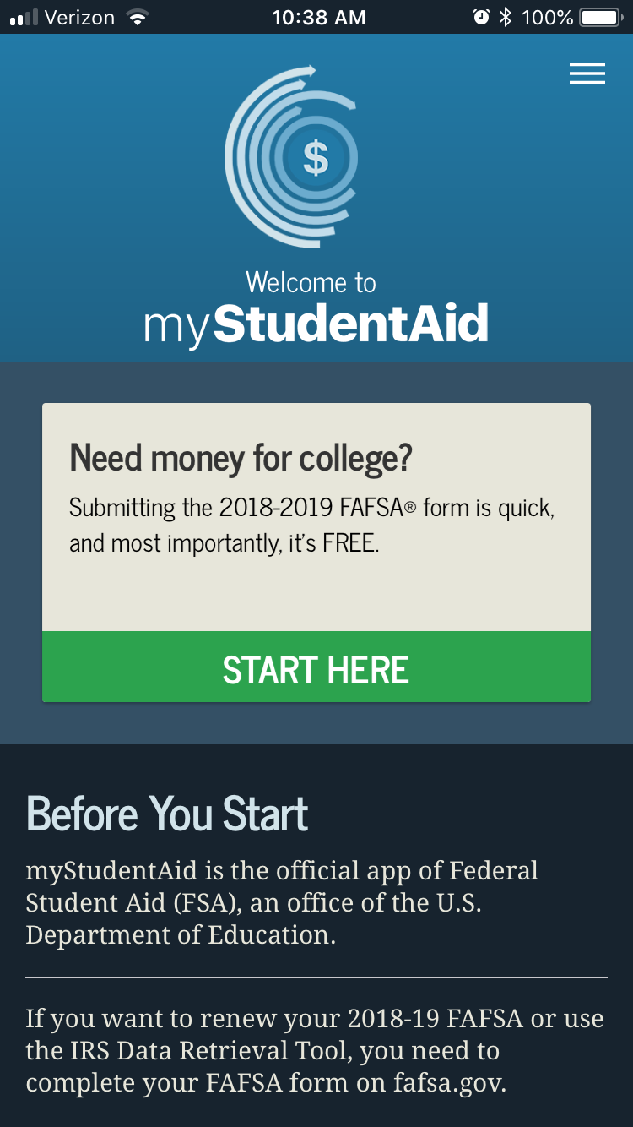
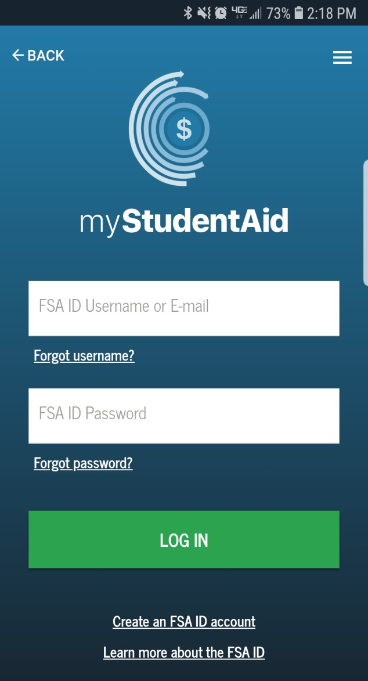
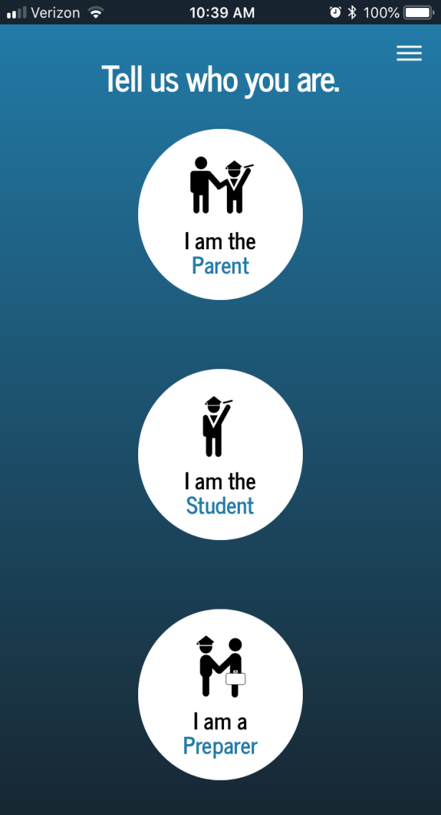
Mobile App
Notes:
Susan

Slide 9
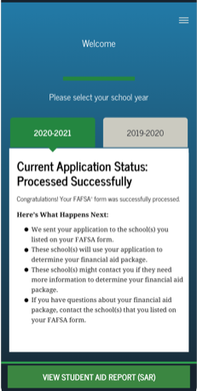
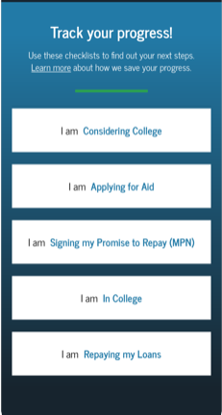
Notes:
Susan

Slide 10
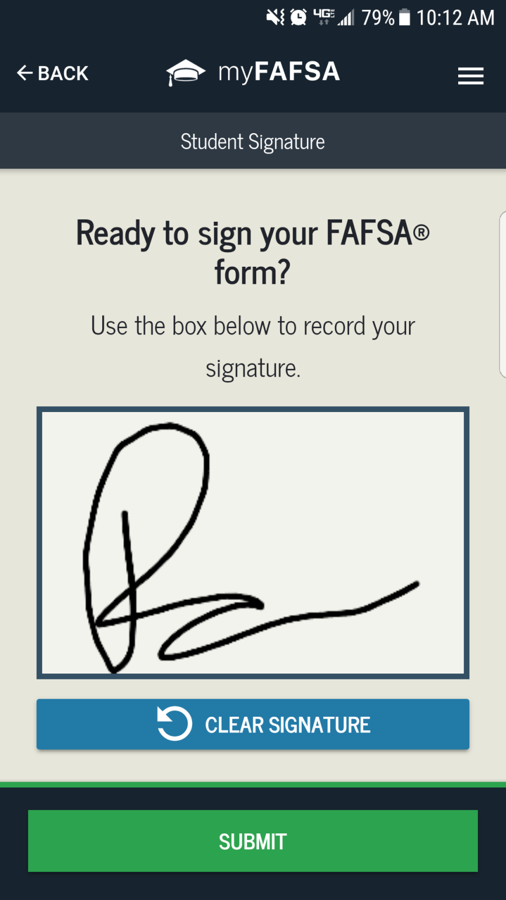
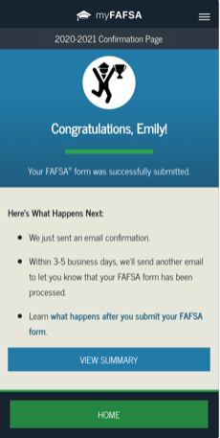
After the student signs, then the parent information will be completed and signed for.
Notes:
Susan

Slide 11
Financial Aid Terms to Know
EFC
Budget/Costs
Award Package
SAP-Standards of Academic Progress
Dependency Status
Verification
Need
CSS Profile
Notes:
Yvette
What is Expected Family Contribution (EFC)?-A federal government calculation from the data you provided on the FAFSA
stays the same regardless of college
Both Income and assets of student and parent are reviewed
Award Package- A listing of all funds made available to the student for one academic year from one college. May include funds from the institution, federal government, state government, and outside sources.
Satisfactory Academic Progress-Satisfactory Academic Progress (SAP) is required by all institutions. Students must maintain a certain GPA in order to keep their financial aid and they must have a cumulative 67% passing rate.
The GPA for institutional aid (merit awards) may be different from the federal requirements. Please check with the school you will be attending.

Slide 12
What is Expected Family Contribution (EFC)?
Stays the same regardless of college
Two components
Parent contribution
Student contribution
Calculated using data from a federal application form and a federal formula

Slide 13
Budget/ What is Cost of Attendance (COA)?
There are 5 categories
Tuition and Fees
Room and meal plan
Books and Supplies
Transportation
Personal Expenses
The total of these categories equals the COA.
The COA less EFC equals need.
Need is used to determine your financial award and will vary from
college to college.
Direct costs
Indirect costs
Notes:
Yvette

Slide 14
Award Package
All awarded funds from a college.
Types include:
Merit Aid
Federal Aid
State Aid
Other institutional aid
Outside scholarships

Slide 15
Satisfactory Academic Progress
Satisfactory Academic Progress (SAP) is required by all institutions. Students must maintain a certain GPA in order to keep their financial aid and they must have a cumulative 67% passing rate.
The GPA for institutional aid (merit awards) may be different from the federal requirements. Please check with the school you will be attending.

Slide 16
Dependent/Independent Students
Dependent students must include parental information on the FAFSA.
Dependent Students are students who cannot answer yes to one of the following:
Student is at least 24 years old
Student is a graduate or professional student
Student is married
Student is supporting children
Student is an orphan or ward of court
Student is a veteran of the U.S. Armed Forces
Notes:
Yvette

Slide 17
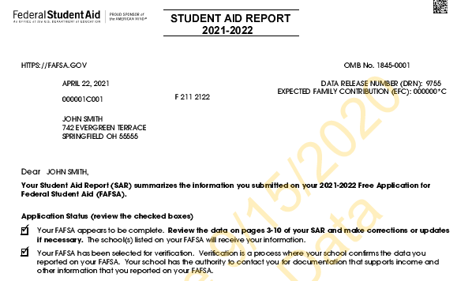
Verification
30% to 35% of all FAFSA filers are selected
Some schools verify 100% of filers
You may link your taxes to your FAFSA (DRT)
Documents that may be requested to verify information on the FAFSA
Tax transcripts for parents and students
Verification worksheet
Maybe W-2’s Parents and Students
Notes:
Yvette

Slide 18
CSS Profile
Some colleges use this to determine institutional funds
The cost is $25
$16 for each additional school
Very detailed financial information
Not all schools use all questions
Notes:
Yvette

Slide 19
Types of Government Aid
“Free Money”
Loans-Student
Loans-Parent
Work Study
Notes:
Susan

Slide 20
Who is Eligible for Federal Student Aid?
U.S. citizen or permanent resident
High school graduate/GED holder
Eligible degree/certificate program
Valid Social Security number
Males registered for Selective Service
Satisfactory academic progress in college/career school
Notes:
Susan

Slide 21
Federal aid break down
Pell Grant-Max is $6395 20-21
FSEOG-to students who qualify for the Pell Grant
Direct Student Loans-All students, repayment 6 months after student leaves school with a 10 year repayment (other options available)
Subsidized - Government subsidizes the interest
Unsubsidized - Student pays the interest
Parent Plus Loan- credit check is done by Federal Government, and repayment may begin after second disbursement. Loan maybe deferred while student is in school
Federal Work-Study- paid for based on hours worked
Notes:
Susan

Slide 22
State Aid (Maryland Programs)
Senator
Delegate
Guaranteed Access Grant
Educational Assistance Grant
Deadline is March 1, FAFSA required and include at least one MD School
Applications at https://MHEC.state.md.us
Student must log in and accept award at https://MDCAPS.mhec.state.md.us
Contact Senator / Delegate
Determined by FAFSA
Notes:
Susan

Slide 23
Additional Aid
What is it?
Where to find it?
How to obtain it?
What about VA Benefits?
Notes:
Yvette

Slide 24
Institutional Aid
Merit aid-funds awarded to students based on grades, extra-curricular activities, and information found on the college application. These amounts are awarded through the admission office.
Need based-funds are awarded by the Office of Financial Aid
Other institutional funds may be awarded, however a separate application maybe required. Frequently these funds are “endowed” and have certain requirements with them.
Notes:
Yvette

Slide 25
VA Benefits
Federal:
Student needs to obtain a “Certificate of Eligibility” from the Veterans Affairs office
If the student is the Veteran may need DD-214
This is for all Post 9/11 benefits
Colmery Forever GI Bill
https://www.benefits.va.gov
https://www.vets.gov
State:
Edward T. & Mary A. Conroy Memorial Scholarship Program and Jean B. Cryor Memorial Scholarship Program
Veterans of the Afghanistan and Iraq Conflicts Scholarship Program
Notes:
Yvette

Slide 26
Other Funding Options
Scholarships and Grants
Civic Scholarships and Grant
Trusted Scholarship Search Engines
Employer assistance
Private loans
Loans from alternative/private sources
Mortgage Refinance or pay out mortgage
Retirements Accounts/Loans-401K
Notes:
Yvette

Slide 27
Self-Help Aid – Other Loans
Private Education Loans
Also known as supplemental or alternative loans
Borrowed by the student or parent
Interest begins accruing at disbursement to the school
Banks and other lending institutions are the source of the funds
Credit-based
PROCESS may vary but most are similar
Borrower’s (and co-signer’s) credit will be checked to determine eligibility
Application through disbursement may take time, so begin early (usually before August)
Compare/shop, and determine what is best for the student and family
Notes:
Yvette

Slide 28
Planning ahead
Students need to remember to account for EVERY year that they will be in school (not just the first year), including graduate/professional school
Begin saving at ANY time before college, including summers
Prepare a budget to take into account costs for 4+ years of school
Review school “cost of attendance” information
Be creative; consider all possible ways to fund, including school payment plans to help reduce debt
Notes:
Yvette

Slide 29
Outside Scholarships and Grants
Civic Organizations
Check with your high school counselors
Varying amounts, due dates, criteria
https://fastweb.com
https://myscholly.com
www.scholarship.com
www.central-scholarship.org
www.gocollege.com
www.cffredco.org
https://collegeboard.org
www.cfwcmd.org
Notes:
Susan

Slide 30
Helpful Web Sites:
https://studentaid.gov
https://FSAID.ed.gov
www.mhec.state.md.us
www.hood.edu
https://studentloans.gov
https://sss.gov
https://www.nasfaa.org/State_Financial_Aid_Programs
Notes:
Susan

Slide 31
Questions?????
The Office of Financial Aid
Contact information
Finaid@hood.edu
301-696-3411
Today’s presentation can be found at: www.hood.edu/finaidpresentation
Notes:
Melena-wrap up
All of us will stay up for questions

