Slide 1
How to pay for college
Financing Education
Loans and scholarships
Presented by Hood College Office of Financial Aid
Notes:
Bill to do welcome
Melena to introduce the Financial Aid Office members

Slide 2
It’s all about the FAFSA
Free Application for Federal Student Aid
Free Application for Federal Student Aid
A standard form that collects demographic and financial information about the student and family
Filed online at https://studentaid.gov
Required for all Federal Aid and some states aid
myStudentAid App
Notes:
Susan

Slide 3
Who is Eligible for Federal Student Aid?
U.S. citizen or permanent resident
High school graduate/GED holder
Eligible degree/certificate program
Valid Social Security number
Males registered for Selective Service
Satisfactory academic progress in college/career school
Notes:
Susan

Slide 4
The steps:
1-Obtain FSA ID (Federal Student Aid Password/Signature) at: https://FSAID.ed.gov
2-Fill out all parts of the FAFSA
make sure to answer all questions and when asked, put a zero (0) in for dollar amounts
October 1, 2020 for 2021-2022 use 2019 taxes
October 1, 2021 for 2022-2023 use 2020 taxes
IRS Data Retrieval Tool (DRT)-IRS Information links with the FAFSA
3- Receive your Student Aid Report (SAR) from the federal processor
The SAR will include your Expected Family Contribution (EFC). This will be the same number/calculation for all schools.
EFC is an index used to determine government and institutional funds.
This is not always an accurate picture of what you can afford.
4- Make corrections if needed
Send all requested documents to the College/University your student has chosen
An award Package will now be created for your student by the Financial Aid offices

Slide 5
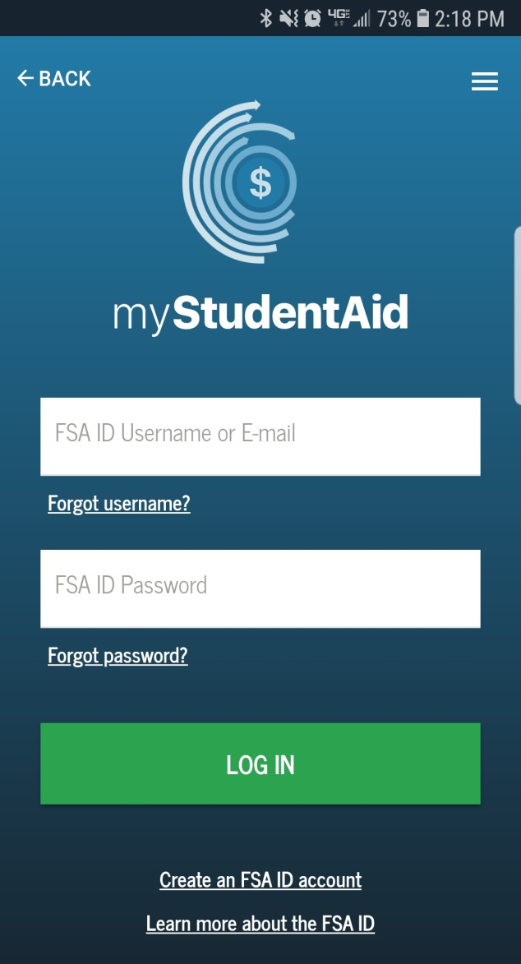
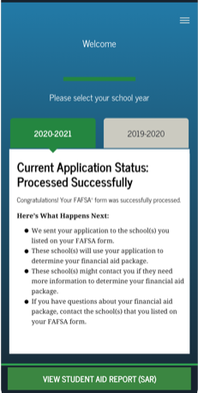
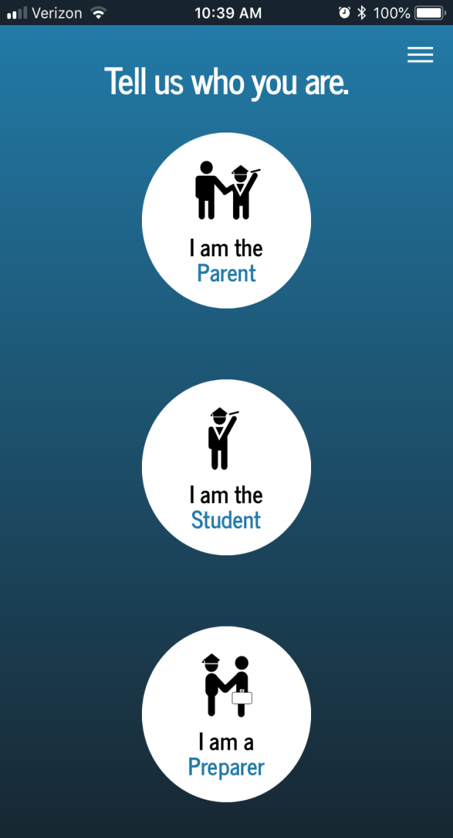
Mobile App Available in December
Notes:
Susan

Slide 6
Frequent FAFSA Errors
Social Security Numbers
Divorced/widowed/remarried parental information
Income earned by parents/stepparents
Untaxed income
U.S. income taxes paid
Household size
Number of household members in college
Real estate and investment net worth
Notes:
Susan

Slide 7
General Types of Aid
Gift Aid
Funds such as grants or scholarships that do not require repayment
Self-help
FWS
Loans

Slide 8
Dive deeper
Verification
SAP-Standards of Academic Progress
Cost of Attendance/Budget
Scholarships
Loans

Slide 9
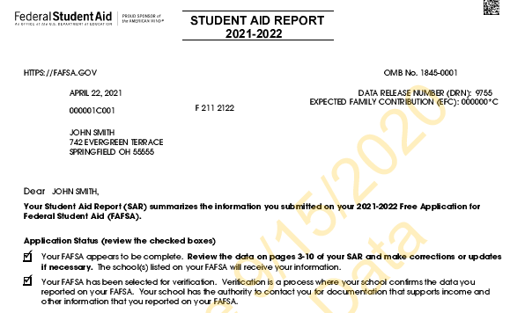
Verification
30% to 35% of all FAFSA filers are selected
Some schools verify 100% of filers
You may link your taxes to your FAFSA (DRT)
Documents that may be requested to verify information on the FAFSA
Tax transcripts for parents and students
Verification worksheet
Maybe W-2’s Parents and Students
Notes:
Yvette

Slide 10
Satisfactory Academic Progress
Satisfactory Academic Progress (SAP) is required by all institutions. Students must maintain a certain GPA in order to keep their financial aid and they must have a cumulative 67% passing rate.
The GPA for institutional aid (merit awards) may be different from the federal requirements. Please check with the school you will be attending.

Slide 11
What is Cost of Attendance (COA)? (often referred to as a budget)
There are 5 categories
Tuition and Fees
Room and meal plan*
Books and Supplies
Transportation
Personal (miscellaneous) Expenses
The total of these categories equals the COA.
*Room and meal plan are only direct costs if student lives on-campus
Direct costs
Indirect costs
Notes:
Yvette

Slide 12
Why does the COA matter?
The COA impacts the amount and type of financial assistance awarded by a school
- The COA is the maximum amount of aid a student may receive in a given year (from all sources)
- The COA in combination with the EFC determine financial need
COA
-EFC
=Need
Need is determining factor in the types of financial assistance offered
and will vary from college to college.

Slide 13
Financial Need
Determines how much and what type of need-based aid
Examples of need-based aid
Federal Pell Grant
Federal work-study
Subsidized loans
Institutional grants
State aid

Slide 14
Scholarships
Institutional Scholarships
Outside Scholarships
Notes:
Susan

Slide 15
Institutional Scholarships
Merit-Based
Aid provided because of achievement or talent
Academic Achievement
Talents such as music or art
Athletics
Criteria varies by institutional
Notes:
Yvette

Slide 16
MD State Scholarships
Need-Based Grants
Howard P. Rawlings Program of Educational Excellence Awards:
Guaranteed Access Grant​​
Educational Assistance Grant
Campus-Based Educational Assistance Grant​
2+2 Transfer Scholarship​
Part-Time Grant
Graduate and Professional Scholarship Program
​​Maryland Community College Promise Scholarship​
​
Legislative Scholarships
Delegate Scholarship
Senatorial Scholarship​
​Career/Occupation-Based Grants & Scholarships
Loan Assistance Repayment Programs
Unique Populations
​https://mhec.maryland.gov/preparing/Pages/FinancialAid/descriptions.aspx

Slide 17
Outside Scholarships
Scholarships provided by a third party (not the institution)
Aid provided because of achievement or talent
Academic Achievement
Talents such as music or art
Athletics
Criteria varies by Organization
Notes:
Yvette

Slide 18
How to find outside scholarships
Civic Organizations
Check with your high school counselors
Varying amounts, due dates, criteria
https://fastweb.com
https://myscholly.com
www.scholarship.com
www.central-scholarship.org
www.gocollege.com
www.cffredco.org
https://collegeboard.org
www.cfwcmd.org
Notes:
Susan

Slide 19
Outside scholarship tips
Plan ahead
Set up a spread sheet with:
Due dates
Document requirements
Amounts offered
Lead time
Submit all documents at one time
Prepare several essays
Look at unconventional options
Dedicate time
Think of all your major variations
i.e. for business you could also look at accounting, finance, marketing. For IT related you could look at: web design, cybersecurity, networking, software development etc.
You can do the work-no need to pay someone

Slide 20
Loans of all types
Loans-Student
Loans-Parent
Loans-Alternative
Notes:
Susan

Slide 21
Federal Loan Documents/Application
Studentaid.gov

Slide 22
Where to find more loan answers
Studentaid.gov

Slide 23
Loans
Subsidized v. unsubsidized
Subsidized-government pays interest while student is enrolled at least half time
Unsubsidized-the family/student is responsible for interest while the student is enrolled at least half time
You will be offered the maximum that you are eligible for at each college
You to not need to take the full amount of the loan offered, you may reduce the amount offered or decline the loan.
Interest is fixed for each years loan but the interest does change each year for that years loan-the loan you will take out for the academic year of 2021-2022 will have that interest rate until it is paid off. Your loan for 2022-2023 will have a different interest rate until that loan is paid off
Every Federal Loan has an origination fee

Slide 24
Federal Parent PLUS loans
You may choose the amount to borrow or you may choose to be offered the maximum that you are eligible for at each college
You to not need to take the full amount of the loan, you may reduce the amount offered or decline the loan.
Interest is fixed for each years loan but the interest does change each year for that years loan-the loan you will take out for the academic year of 2021-2022 will have that interest rate until it is paid off. Your loan for 2022-2023 will have a different interest rate until that loan is paid off
Every Federal Loan has an origination fee

Slide 25
Annual Student Loan Acknowledgment-new for 21-22
Every borrower will need to log into https:studentaid.gov with their FSA ID and complete this step each year so that loan funds can be disbursed

Slide 26
Loan Repayment
Standard Repayment-10 years
Graduated Repayment-10-30 years
Extended Repayment- up to 25 years
Revised Pay As You Earn Repayment Plan- 20-25 years and 10% of your discretionary income
Income-Based Repayment Plan-20-25 years
Income Contingent
Repayment Plan-25 years
Income Sensitive
Repayment Plan-15 years

Slide 27
Loan Forgiveness/Discharge-federal loans
Public Service Loan Forgiveness after 120 payments
Teacher Loan Forgiveness-Title I schools-up to $17,500
Closed School Discharge
Disability Discharge
Borrower Defense to Repayment
For loan forgiveness-notify servicer each year

Slide 28
Self Help/Other Loans
Private Education Loans
Also known as supplemental or alternative loans
Borrowed by the student or parent
Interest begins accruing at disbursement to the school
Banks and other lending institutions are the source of the funds
Credit-based
PROCESS may vary but most are similar
Borrower’s (and co-signer’s) credit will be checked to determine eligibility
Application through disbursement may take time, so begin early (usually before August)
Compare/shop, and determine what is best for the student and family
Mortgage Refinance or pay out mortgage
Notes:
Yvette

Slide 29
Additional Aid
What is it?
Where to find it?
How to obtain it?
What about VA Benefits?
Notes:
Yvette

Slide 30
Options for parent
Mortgage Refinance or pay out mortgage
Retirement Accounts/Loans 401K

Slide 31
VA Benefits
Federal:
Student needs to obtain a “Certificate of Eligibility” from the Veterans Affairs office
If the student is the Veteran may need DD-214
This is for all Post 9/11 benefits
Colmery Forever GI Bill
https://www.benefits.va.gov
https://www.vets.gov
State:
Edward T. & Mary A. Conroy Memorial Scholarship Program and Jean B. Cryor Memorial Scholarship Program
Veterans of the Afghanistan and Iraq Conflicts Scholarship Program
Notes:
Yvette

Slide 32
Planning ahead
Students need to remember to account for EVERY year that they will be in school (not just the first year), including graduate/professional school
Begin saving at ANY time before college, including summers
Prepare a budget to take into account costs for 4+ years of school
Review school “cost of attendance” information
Be creative; consider all possible ways to fund, including school payment plans to help reduce debt
Notes:
Yvette

Slide 33
Helpful Web Sites:
https://studentaid.gov
https://FSAID.ed.gov
www.mhec.state.md.us
www.hood.edu
https://studentloans.gov
https://sss.gov
https://www.nasfaa.org/State_Financial_Aid_Programs
Notes:
Susan

Slide 34
Questions?????
The Office of Financial Aid
Contact information
Finaid@hood.edu
301-696-3411
Today’s presentation can be found at: www.hood.edu/finaidpresentation
Notes:
Melena-wrap up
All of us will stay up for questions

