Slide 1
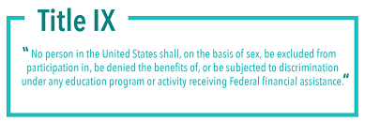

Title IX – New day Training for Title IX Committee
Carol M. Wuenschel
Title IX Coordinator
August 2020

Slide 2
What’s new
Biggest concerns
  Formal Complaints – Live Hearings
  Informal Complaints – Mediation
  Elongated Process – all the notice requirements
  Notice will probably mean change in the “evidence”
  Complicated – lots of room for errors
  Prescriptive reports

Slide 3
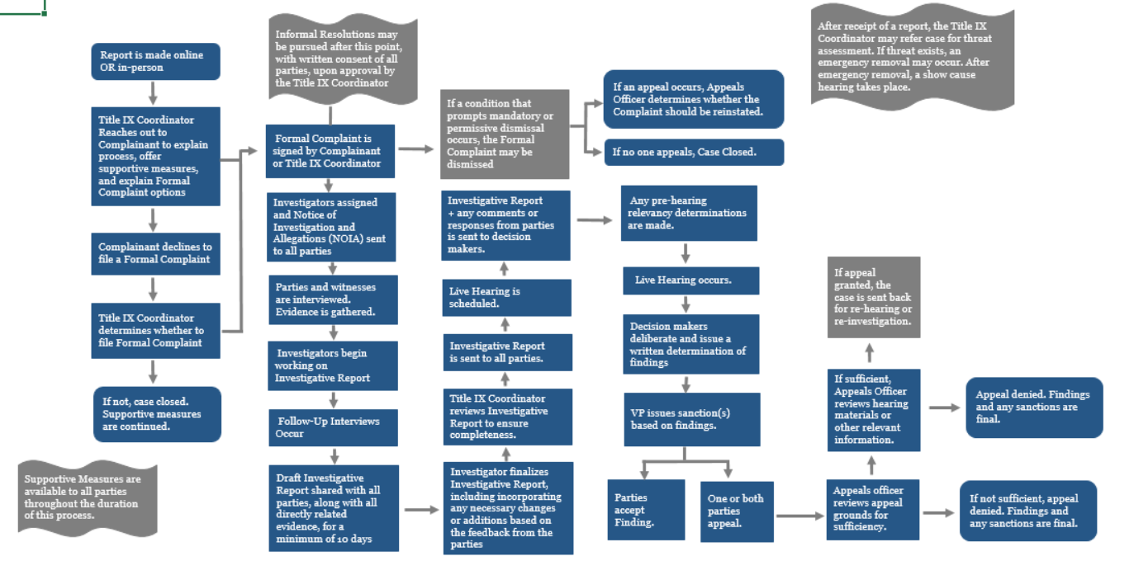
Title IX Complaint Process

Slide 4
Hearing panels
Title IX Coordinator – Convener
Hearing Officer – Grand River Solutions – Attorney
Hearing Panel – Six teams have been selected
Decision-makers
Appeals Officials

Slide 5
Comparing Mount and Hood
Mount St. Mary’s
Hood College
Using similar policy for Title IX case adjudication
Using established processes for the Title VII Sexual Harassment and other covered civil rights
Using new Policy for all civil rights adjudication
Not using live hearing for those civil rights complaints that are not Title IX sexual harassment

Slide 6
Benefits of shared services model
Same Title IX Coordinator to monitor all cases – may have respondent that shows up in multiple locations and we can take action
Joint Title IX Committee Meetings – develop Brain Trust
Joint Title IX Trainings – Cut down on expenses
Provides more transparency
Hood and the Mount will be doing the right things for the right reasons

Slide 7
Your mission
Educate yourself
Educate others
Be an advocate for non-discriminatory practices
Be a brain trust to prevent and respond to Title IX concerns

Slide 8
Title IX resources
Kate Gmuer – Disability to Accessibility
Carley Shannon – Athletics for gender equity and sexual harassment as defined by Title IX
New website
New newsletter

Slide 9
What’s Next
Training, training, training
Simplify a complex process
Meet twice a semester

